Slide 1


Modern Web UI with .NET & Blazor
Daniel Roth
Principal Product Manager
Microsoft

Slide 2


.NET
Your platform for building anything
Desktop
Web
Cloud
Mobile
Games
IoT
AI

Slide 3

.NET 6 adoption
Active users by version
(month since release)
1.8x
>5.6M total

Slide 4








Blazor: Full stack web apps with .NET
ASP.NET Core
Blazor
JS

Slide 5
Blazor components
https://...
Index.razor
SideBar.razor
Dialog.razor

Slide 6
Part of the ASP.NET Core family
Web UI
Services
Extensions
MVC
Razor Pages
SPA
Blazor
HTTP APIs
SignalR
gRPC
Logging
Configuration
Middleware
Routing
Security
Localization
Caching
Options
Compression
Session
Health Checks
…
File Providers
Servers
Worker
Services
Kestrel
IIS
HTTP.sys
Dependency Injection
Hosting
Notes:
ASP.NET Core comes with everything you need to build beautiful web UI and powerful backend services. The addition of Blazor to ASP.NET Core expands the reach of your .NET web apps to the client.

Slide 7
Blazor in .NET 6 LTS
Hot reload
Smaller download size
WebAssembly AOT
Native dependencies
Error boundaries
Dynamic component rendering
Render components from JS
…and much more!
get.dot.net/6
Notes:
I’m pleased to announce the general availability of .NET 6.
Talk to big features in bullets
Go get it and start building!

Slide 8







Ready-made Blazor UI components
PARTNERS
Ready-made Blazor UI components
Notes:
.NET has a rich ecosystem of partners building additional tools and controls to help you build beautiful, full-featured, applications faster.
We have many partners releasing support for Blazor, Winforms, and WPF on .NET Core in their tools and controls today as well. SyncFusion, Radzen, Progress Telerik, GrapeCity, Infragistics and DevExpress all have great controls for multiple app models for .NET Core.
THANK YOU!!
<CLICK>

Slide 9








OPEN SOURCE
Thriving open-source ecosystem
bUnit
Ant Design Blazor
Blazm
BlazorStrap
https://aka.ms/awesome-blazor

Slide 10
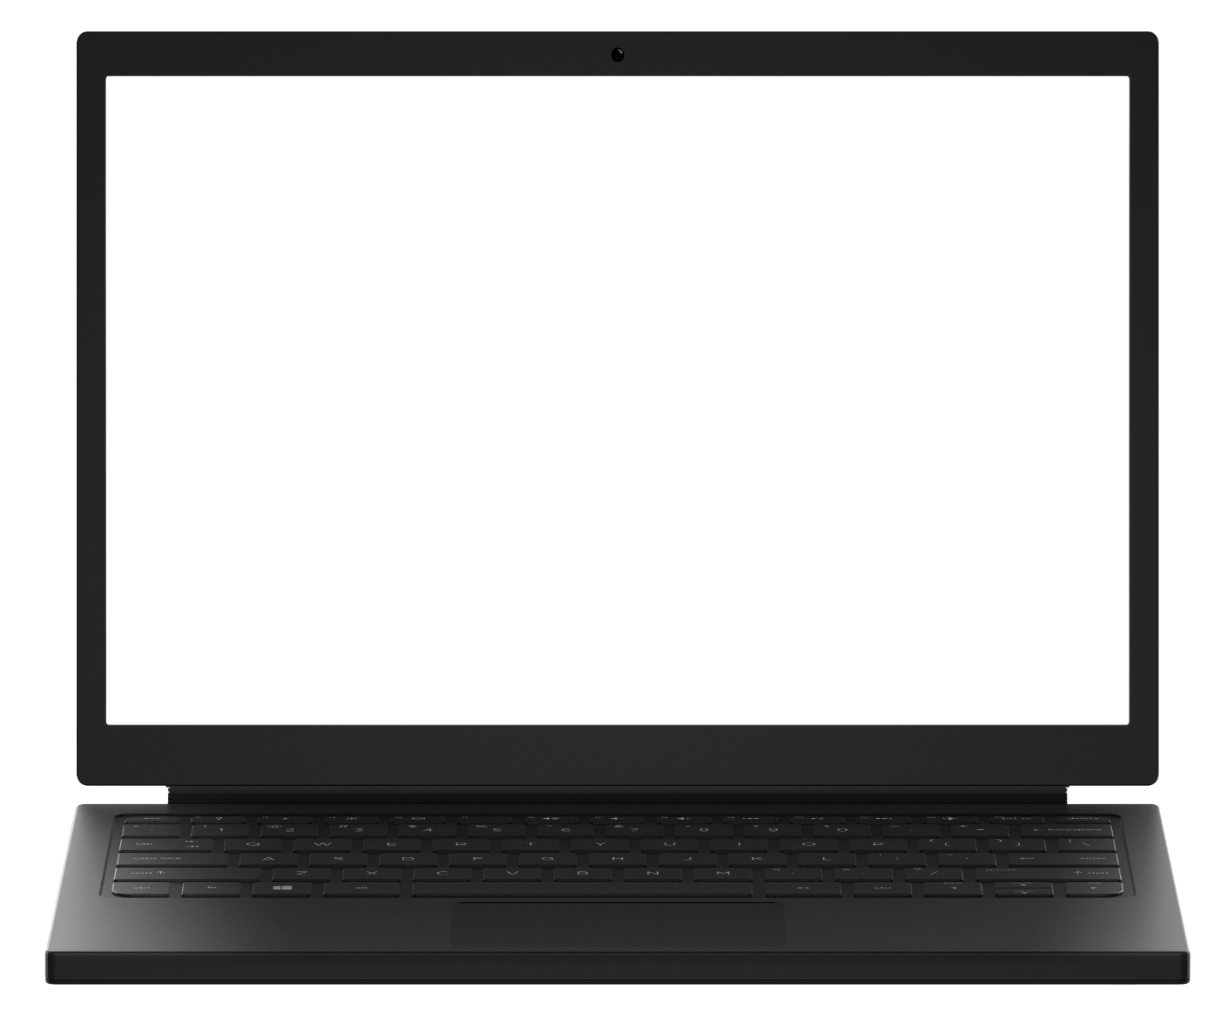
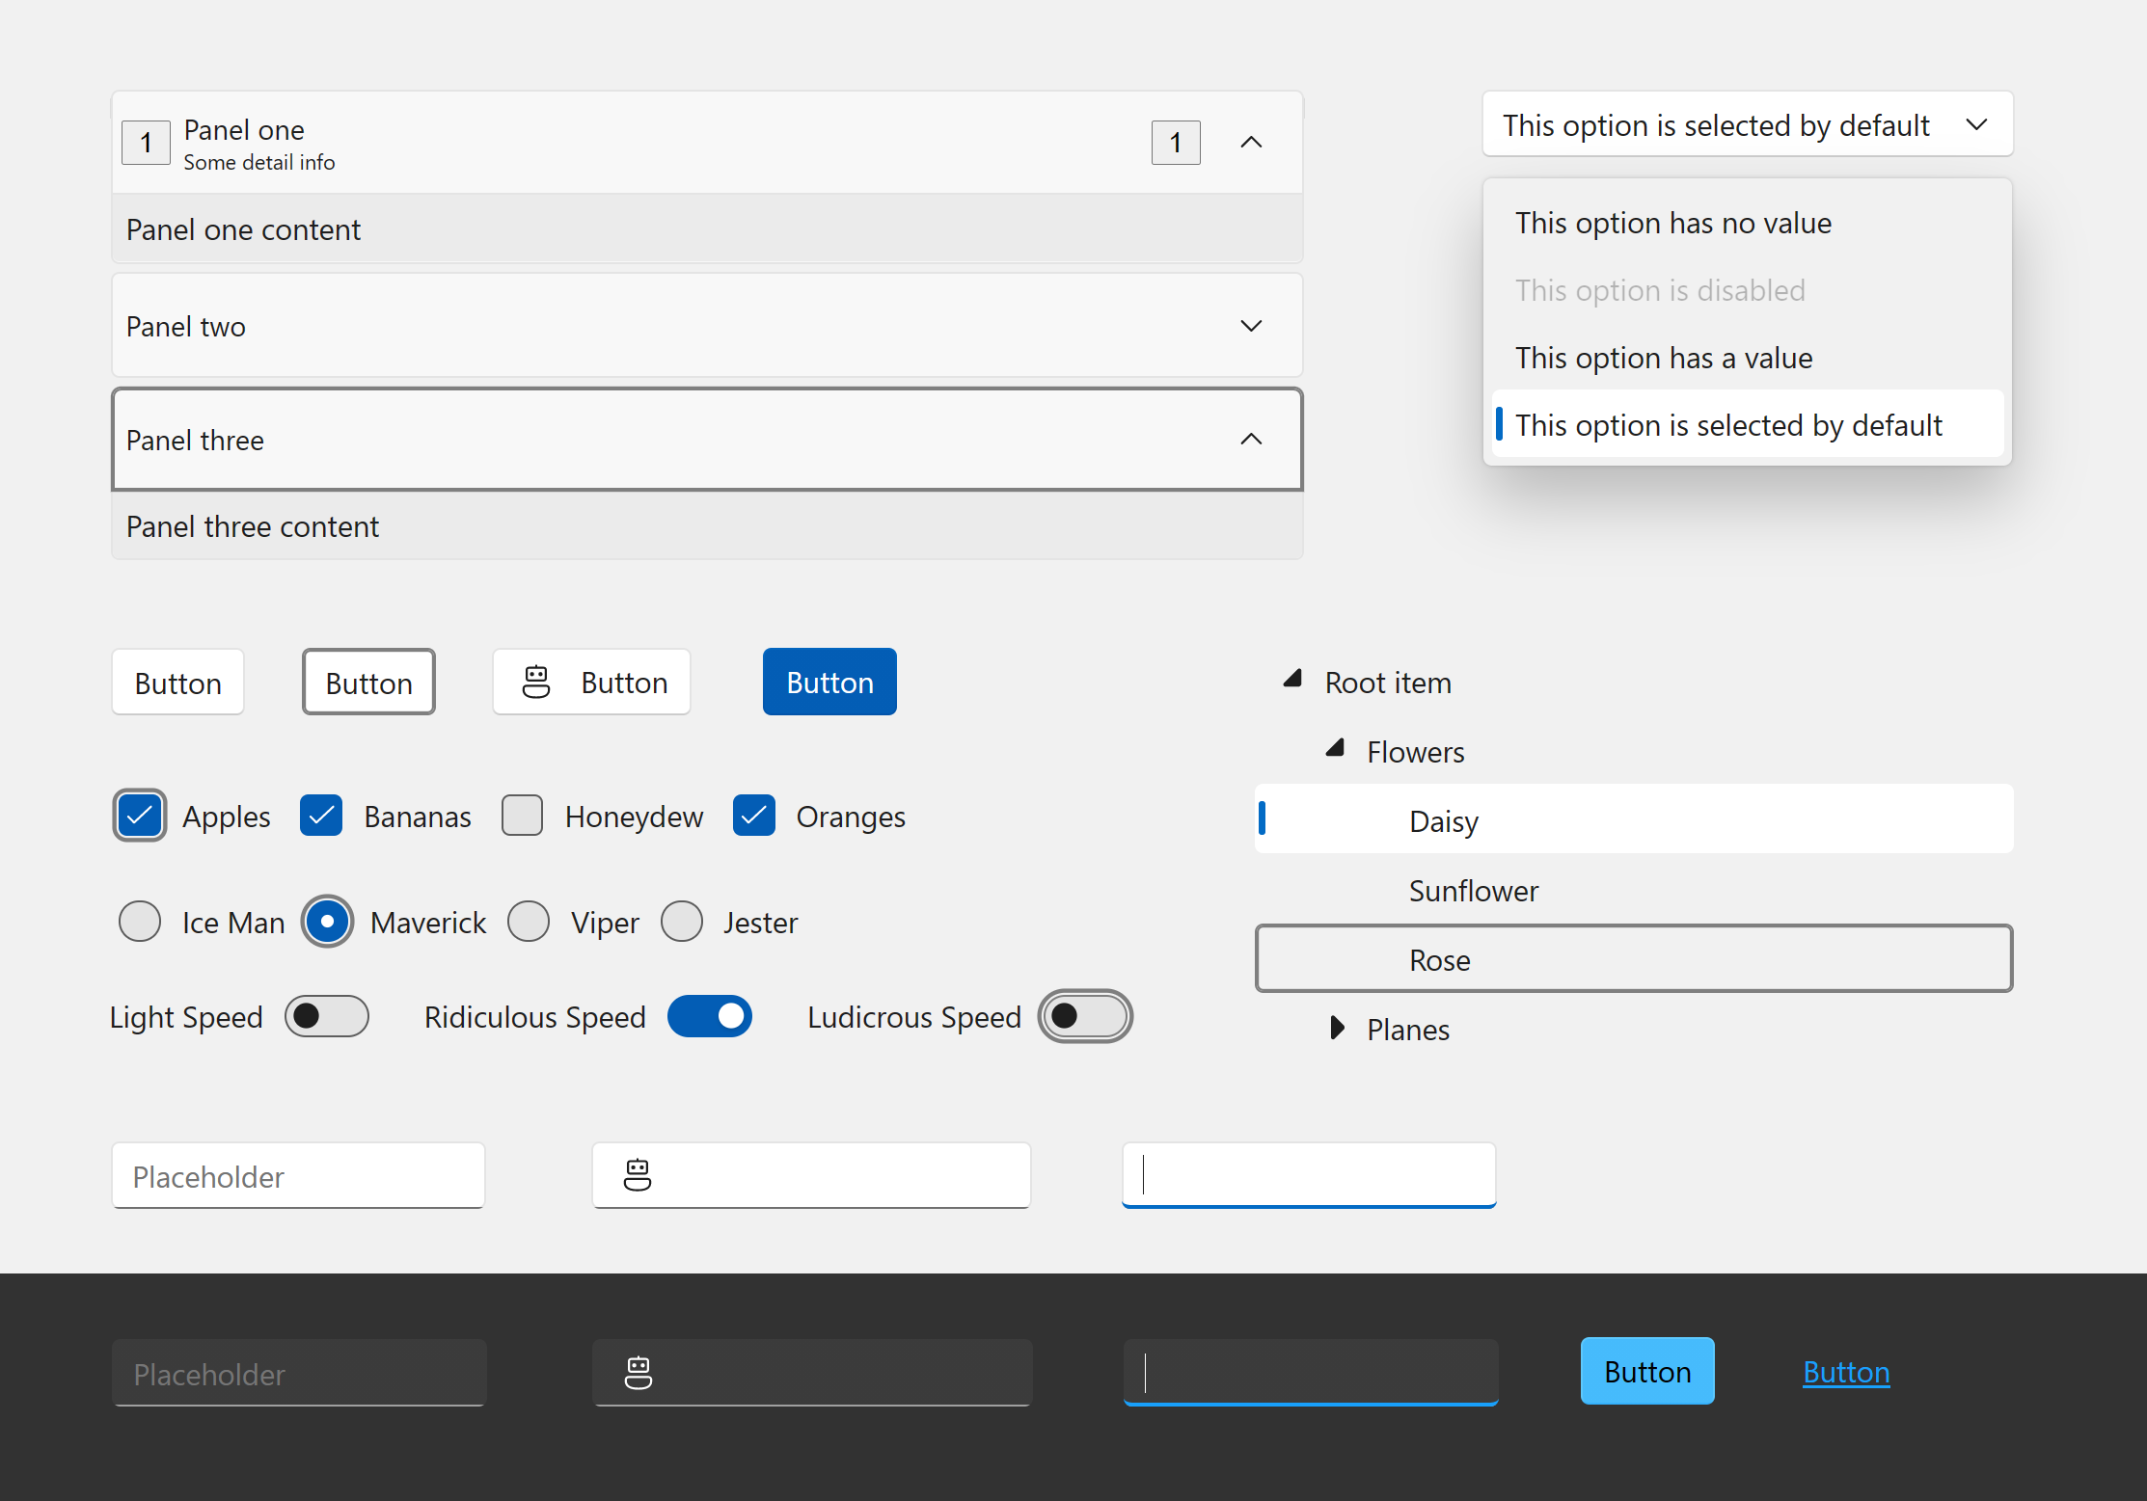
Blazor Fluent UI Components
40+ Blazor components
Fully accessible with light, dark, and high contrast modes
Default styles match the latest Windows 11 Fluent visuals
Integration with web, Windows, Teams, Office, and more
aka.ms/blazor-fluent-ui
Notes:
I’m also happy to announce that the Blazor Fluent UI components have released with over 40 new controls. Fully accessible and styles matching the latest Window 11 fluent visuals.
Check them out and use them in your Blazor apps.

Slide 11


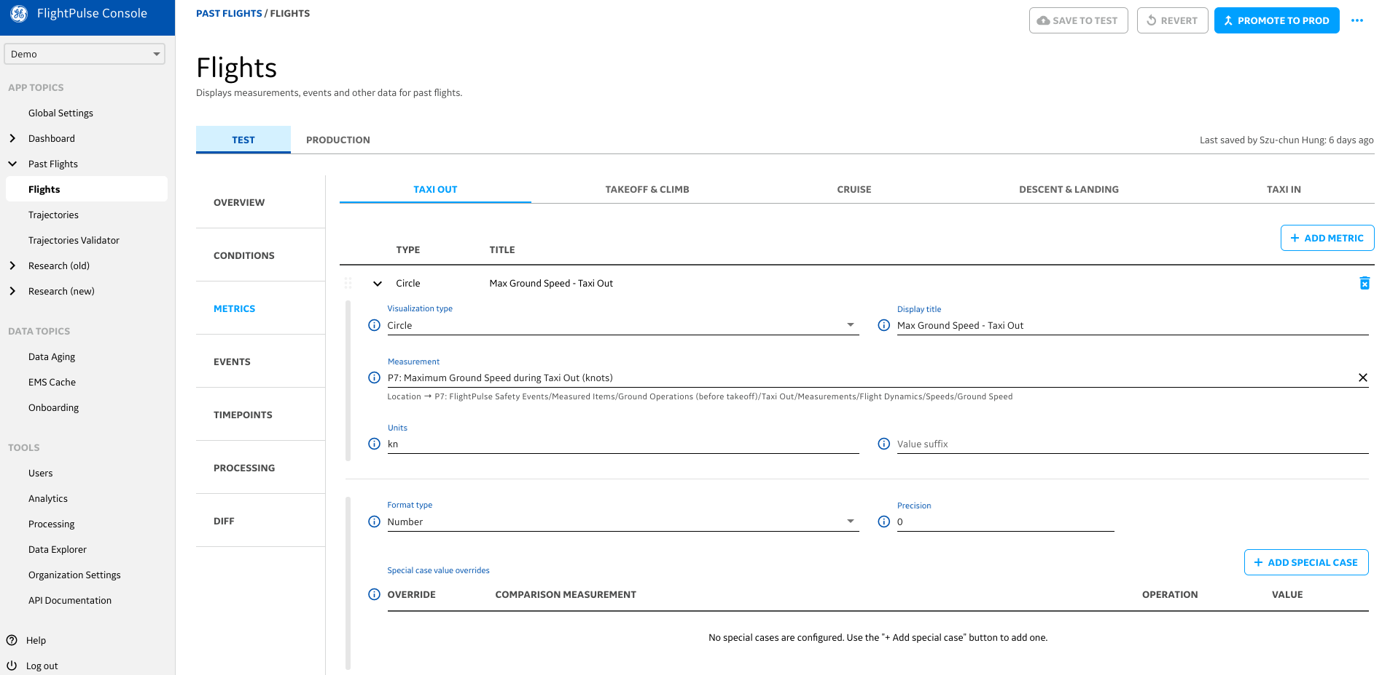
Uses Blazor as part of FlightPulse, an app that puts data and analytics in the hands of more than 3,000 Qantas pilots to help them improve safety and efficiency on every flight.

Slide 12
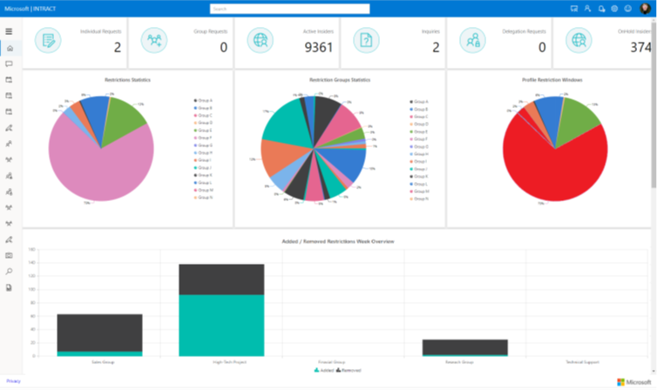
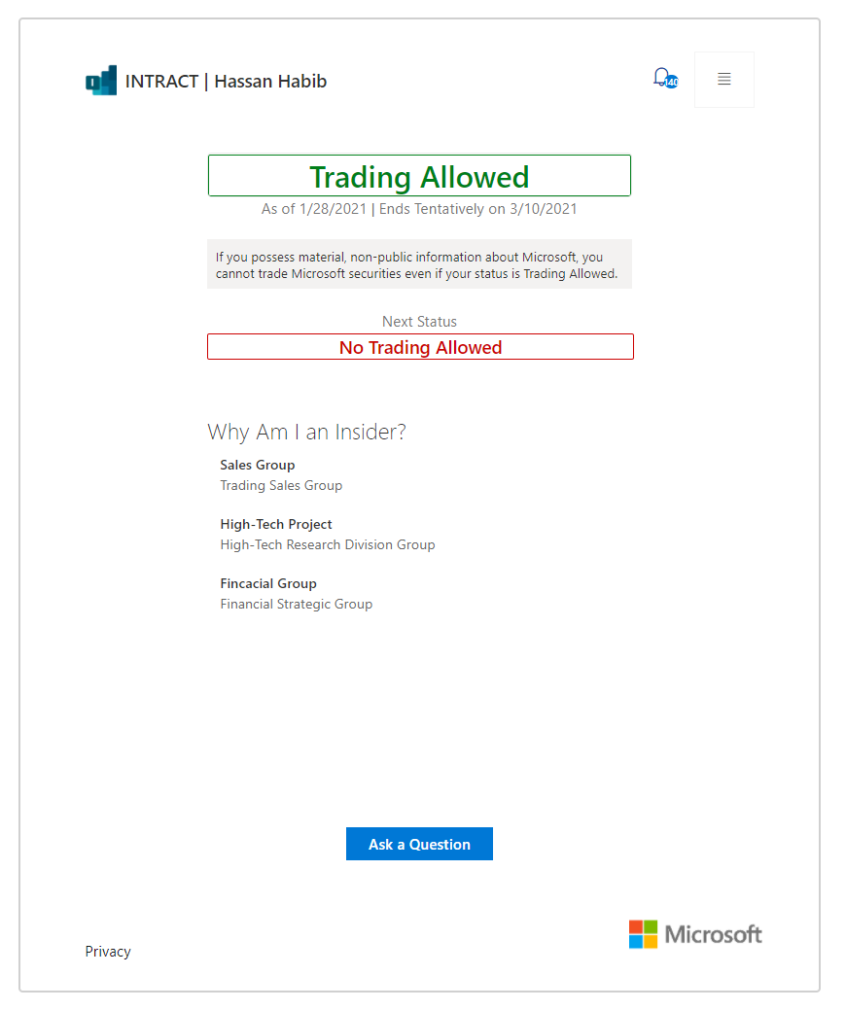
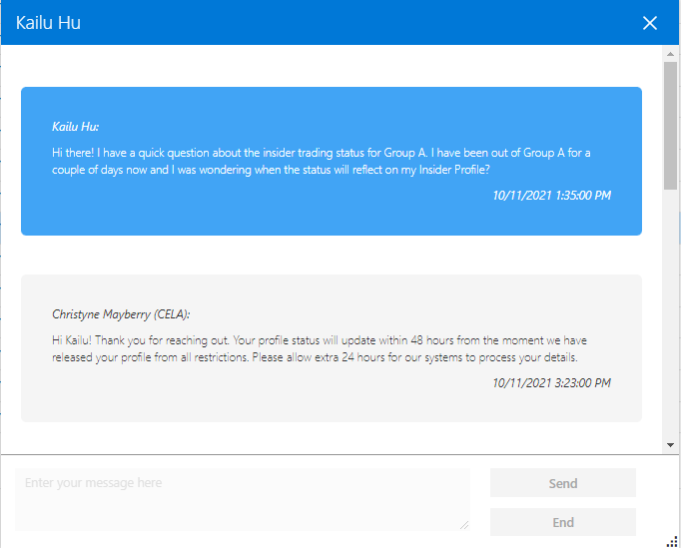
INTRACT (Insider Trading Compliance Platform)
Identify and notify insiders at Microsoft of their responsibilities when trading Microsoft securities.
Administrative functions for tracking groups, managing restrictions, identifying anomalies using machine learning, and reporting.
Also built with ASP.NET Core, Entity Framework Core, ML.NET, and Azure infrastructure.

Slide 13

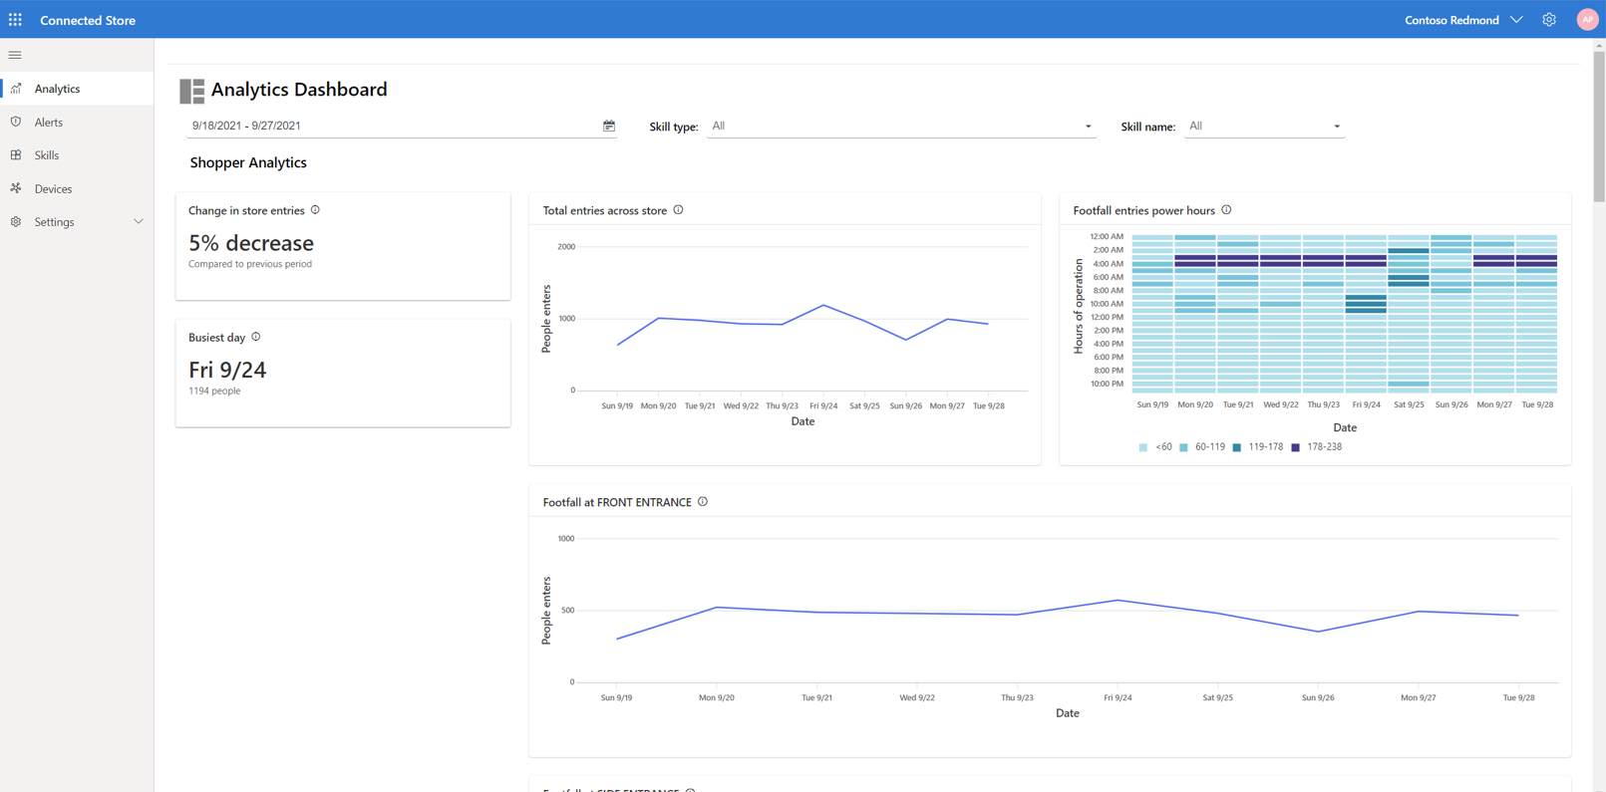
Dynamics 365
Connected Spaces
Optimize in-store operations with real-time observational data.
Blazor web app for in-store setup, monitoring, and training custom AI actions.

Slide 14


How it works
Blazor Server
Blazor WebAssembly
https...
https://...
Blazor
ASP.NET Core
Razor Components
DOM
Blazor
DOM
SignalR
.NET
Razor Components
WebAssembly
.NET

Slide 15
Choosing your Blazor hosting model
Blazor Server
Full access to server capabilities
Fast to startup
Code never leaves the server
Supports thin clients
Requires persistent connection
Higher UI latency
Blazor WebAssembly
Runs fully client-side
No required server component
Host as a static site
Can execute offline
Larger download size
Slower runtime performance

Slide 16
Shared component model
Blazor Server
Blazor WebAssembly
https...
https://...
Blazor
ASP.NET Core
Razor Components
DOM
Blazor
DOM
SignalR
.NET
Razor Components
WebAssembly
.NET

Slide 17




Get started with Blazor
Go to https://blazor.net
Install the .NET SDK
Visual Studio
Visual Studio for Mac
Visual Studio Code
+ C# extension

Slide 18
Demo
Blazor for the web

Slide 19
.NET WebAssembly build tools
Ahead-of-time (AOT) compilation
Runtime relinking
Native dependencies

Slide 20

Blazor WebAssembly trimming
.NET 5
.NET 6
Publish size: 1.7 MB
Publish size: 1.0 MB
~40% size reduction

Slide 21

Blazor beyond the web
Web
Desktop
Mobile

Slide 22



Blazor Hybrid apps
Native desktop app
Web view
Web view
Blazor
.NET
Blazor
.NET
Native mobile app

Slide 23
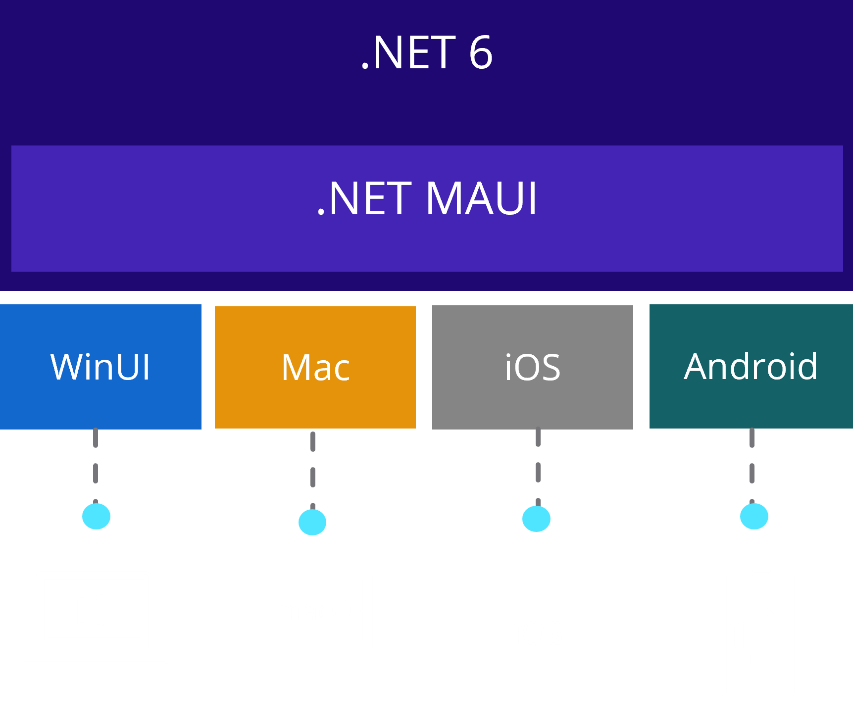
.NET Multi-platform App UI (MAUI)
Cross-platform, native UI with C# and XAML
Single project system, single codebase
Deploy to multiple devices, mobile & desktop
Access native device capabilities from a single API
Develop quickly and iteratively with Visual Studio
dot.net/maui
Notes:
In order to reach all of these devices with beautiful app experiences, we built .NET MAUI and I’m happy to announce it’s release!
.NET MAUI is the most productive way to develop native apps that perform great on any device that runs Android, iOS, macOS, or Windows from a single codebase.​
.NET MAUI under the hood uses technologies out there today for building native apps on Windows with WinUI, Mac Catalyst for macOS, and of course, iOS and Android. .NET MAUI abstracts all those frameworks into a single framework built on .NET 6.
.NET MAUI on Windows supports WinUI allowing these apps to use all the newest native features on supported versions of Windows 10 and 11.
That means you can build all these apps for any device from a single codebase and project system. Instead of learning different stacks and languages for each, you can use one language, one set of libraries, and one UI stack for all of them.

Slide 24
Hybrid apps with Blazor & .NET MAUI
Reuse UI components across native and web
Mix & match web and native UI
Directly access native device functionality
Blazor
aka.ms/maui/blazor
Notes:
I’m happy to announce the release of .NET Multi-platform App UI!
.NET MAUI is the most productive way to develop native apps that perform great on any device that runs Android, iOS, macOS, or Windows from a single codebase.​
.NET MAUI under the hood uses technologies out there today for building native apps on Windows with WinUI, Mac Catalyst for macOS, and of course, iOS and Android. .NET MAUI abstracts all those frameworks into a single framework built on .NET 6.
.NET MAUI on Windows supports WinUI allowing these apps to use all the newest native features on supported versions of Windows 10 and 11.
That means you can build all these apps for any device from a single codebase and project system. Instead of learning different stacks and languages for each, you can use one language, one set of libraries, and one UI stack for all of them.

Slide 25
Demo
.NET MAUI Blazor apps

Slide 26
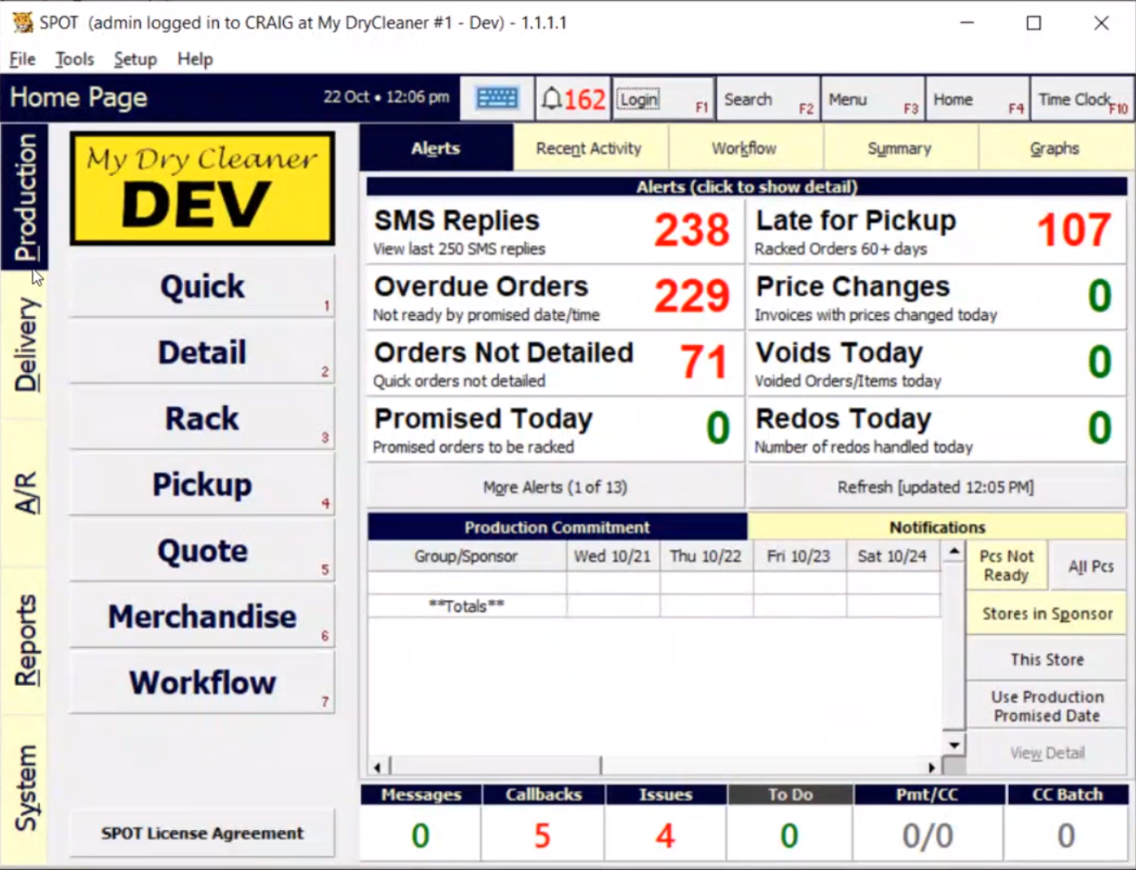
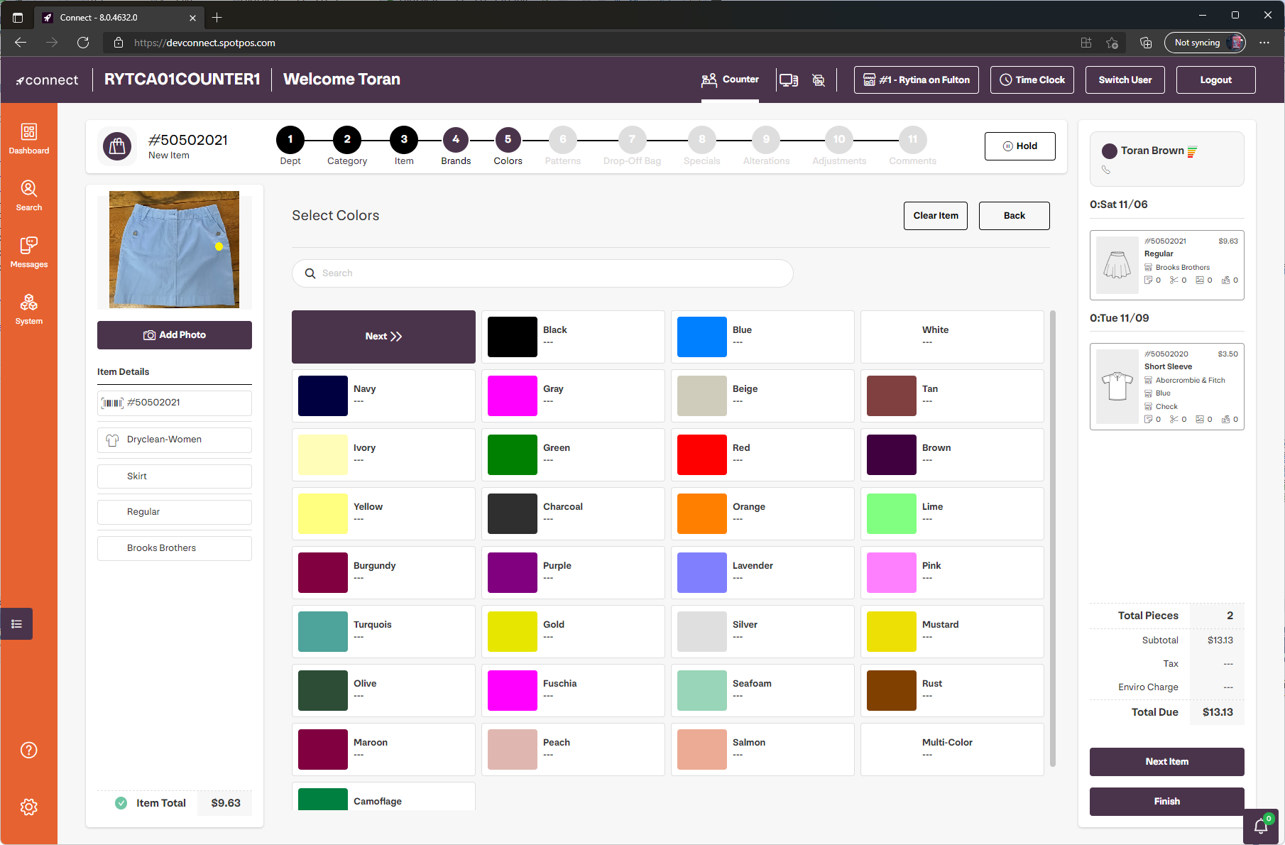



Modernize with Blazor Hybrid UI
Add Blazor UI to existing WinForms and WPF apps
Expand your reach to new platforms and users with .NET MAUI and the web
Leverage existing .NET investments

Slide 27
Demo
Blazor Hybrid with WPF and Windows Forms

Slide 28
Reach & Power
BLAZOR
BLAZOR + .NET MAUI
.NET MAUI
C#, HTML, CSS
C#, XAML
Reach
Power
Site
PWA
Electron, CEF
Native App
with WebView
Native App
Web
Hybrid
Native

Slide 29
Blazor in .NET 7
Hot reload & debugging improvements
Improved AOT performance
Web crypto
Improved JavaScript interop
Blazor custom elements
Data binding improvements
Empty template
Enhanced loading page
Handle location changing events
Dynamic authentication requests
Prerendering with authentication
https://aka.ms/aspnet/roadmap

Slide 30
Demo
Blazor in .NET 7: Custom elements

Slide 31
.NET Schedule
May 2022
.NET MAUI
Nov 2021
.NET 6.0
LTS
Nov 2022
.NET 7.0
Nov 2023
.NET 8.0
LTS
Nov 2024
.NET 9.0
Nov 2024
.NET 10.0
LTS
.NET 6.0 LTS, .NET MAUI, & Blazor Hybrid released
.NET 7 Release Candidate 1 now available
Major releases every year in November
LTS for even numbered releases

Slide 32

Thanks for listening!

